Slide 1
SWP2SWB – Social Work in an Unequal World
Lecture 8 – Global poverty and inequality

Slide 2




Lecture overview – Global poverty and inequality
The current context of global poverty and inequality:
    Serr (2017) – current context and impacts on ‘rich’ and ‘developing’ countries
    Global inequality and poverty – current data and trends
    Measuring Multidimensional Poverty

Slide 3

The current context of global poverty and inequality
Serr (2017, Ch 1) identifies a range of factors which are significant in understanding the current context of global poverty and inequality, as well as the various impacts on developed and developing countries:
Globalisation – the current global situation is largely attributed to the detrimental aspects of economic globalisation, particularly reflecting the influence of neoliberal ideology and the dominance of rich countries expressed through global institutions such as the World Bank, IMF and GATT/WTO. Essentially, the benefits have been enjoyed by the privileged minority, and the costs by the disadvantaged majority (ie leading to gross inequalities and persistent issues with poverty)
Global economic crises – Serr argues that capitalism is prone to crisis, as has been demonstrated both historically (eg Great Depression in 1920’s, 1970’s recessions) and most recently in the global financial crisis (2007-09). Such crises tend to impact most on the poorest and significantly constrain efforts to address poverty and inequality
Austerity measures in many developed countries – the current post-GFC context is characterised by significant cuts to public spending and reductions in welfare provisions – thus exacerbating problems of poverty and inequality
System failures in capitalism and neoliberal economic globalization are need of reform because they advantage rich nations and lead to inequalities both within and between countries.
Persistent inequality and poverty in developing countries – whilst acknowledging the impacts on richer countries, Serr clearly identifies that it is the poorest nations, regions and populations that are worst hit by neoliberal globalisation and resulting crises – a fact that largely mirrors historical trends

Slide 4
Global inequality and poverty – current data and trends
Inequality continues to be a major global problem:
“World leaders, in adopting the Millennium Declaration in 2000, pledged to create a more equitable world. Yet, income inequality has increased in many countries over the last few decades, as the wealthiest individuals have become wealthier while the relative situation of people living in poverty has improved little. Disparities in education, health and other dimensions of human development still remain large despite marked progress in reducing the gaps. Various social groups, especially indigenous peoples, persons with disabilities and rural populations, suffer disproportionately from income poverty and inadequate access to quality services and, generally, disparities between these groups and the rest of the population have increased over time” (United Nations Department of Economic and Social Affairs, 2013 p. 21)
“It is hard to get a clear picture of inequalities in human development and how they are changing. In part because they are as broad and multifaceted as life itself. In part because the measures we rely on, and the data that underpin them, are often inadequate. Yet important patterns repeat again and again. In every country the goalposts are moving. Inequality in human development is high or increasing in the areas expected to become more important in the future. There has been some progress worldwide in fundamental areas, such as escaping from poverty and receiving a basic education, though important gaps remain. Yet at the same time, inequalities are widening higher up the ladder of progress” (UNDP, 2019, p. 352).
Income inequality has increased overall, but the global picture is complex:
“Income distribution has become increasingly unequal in the majority of developed countries and some large developing countries in the last twenty years, but trends differ markedly between countries and regions” (United Nations Department of Economic and Social Affairs, 2013 , p. 29).
Government policies relating to income re-distribution (taxation, social welfare etc) are key:
“A significant part of the difference observed in disposable income disparities across countries can be explained by the redistributive impact of social transfers and taxes” (United Nations Department of Economic and Social Affairs, 2013 , p.37).

Slide 5
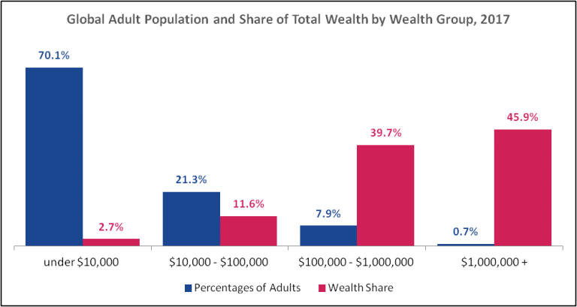
Global wealth inequality…
The top 0.7% of global adult population (with net wealth over $1 million each) hold 45.9% of global wealth
The bottom 70.1% of global adult population (with net wealth under $10 000 each) hold only 2.7% of global wealth
The top 8.6% of the global adult population combined own a staggering 85.6% of global wealth
This leaves the bottom 91.4% of the global adult population holding only 14.3% of global wealth.
This illustrates that global wealth inequality is even more severe than global income inequality
Source: Inequality.org using data from Credit Suisse Global Wealth Report, 2017

Slide 6
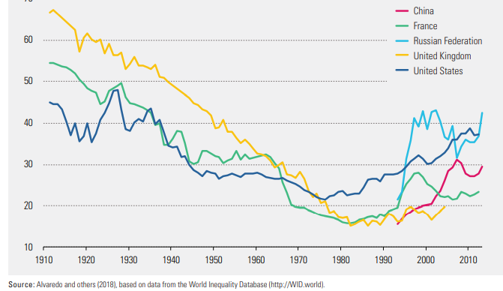
Global wealth inequality…
Wealth inequality has been increasing since 1980, despite the 2008 global financial crisis
“Wealth is substantially more concentrated than income: In 2017 the global top 10 percent (the richest 10 percent in the United States, Europe and China) owned more than 70 percent of the total wealth, and the top 1 percent owned 33 percent, while the bottom 50 percent owned less than 2 percent” (UNDP, 2019, p. 131)
Source: UNDP, 2019.

Slide 7
Trends in global income inequality
Data on global income inequality are complex, and highlight different and somewhat competing trends
Firstly, there appears to have been a decline in overall inequality between countries (yellow bars) based on comparisons of average incomes. Some critics point out that this measure is heavily skewed by significant economic growth in a few countries (eg China, India) (Hulme 2019)
Over the same period, the data also highlights that income inequality within countries is actually increasing (red bars). Critics suggest this highlights that economic growth in developing countries is benefiting a small proportion of elites, rather than being distributed more equitably within the country
Such trends highlight some of the challenges and contradictions in global economic development efforts
(Source: World Bank Group, 2016)

Slide 8
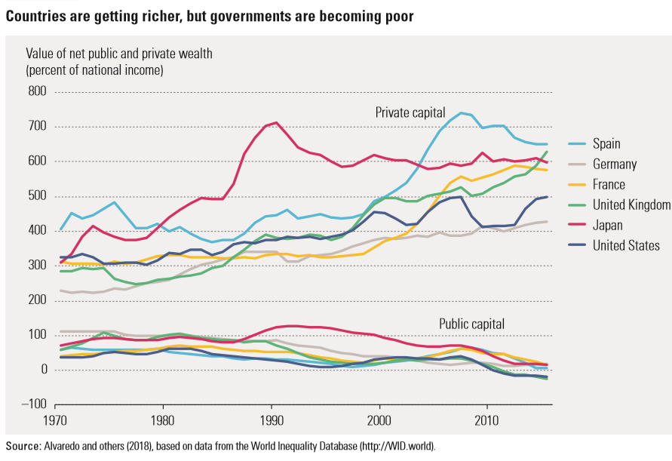
“The long-run decline in the share of public wealth in total wealth, in no way inevitable, is the result of public policy choices (privatizing public assets)”
(UNDP 2019)

Slide 9
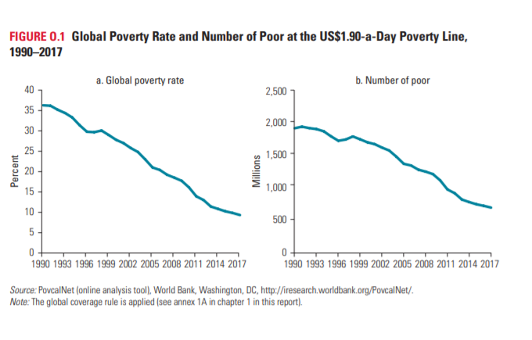
Trends in global poverty
The last year for which global poverty was reported is 2017, and analysis show that poverty reduction was slowing before the COVID 19 crisis.
“The past 25 years have seen remarkable progress toward ending extreme
poverty. The number of people living below the IPL decreased from 1.9 billion in 1990 to 741 million in 2015. This decreasing trend is confirmed by the data for 2017. Poverty has fallen further, to 689 million (figure 1.1, panel b)—52 million less than in 2015 and 28 million less than in 2016 (see annex 1A, table 1A.2). Yet the number of people living in extreme poverty remains unacceptably high, and there are several reasons to believe that the target of reducing the share of people living in extreme poverty to below 3 percent by 2030 will not be achieved”.
(World Bank, 2020, p. 32)
Source: Worldbank, 2020

Slide 10
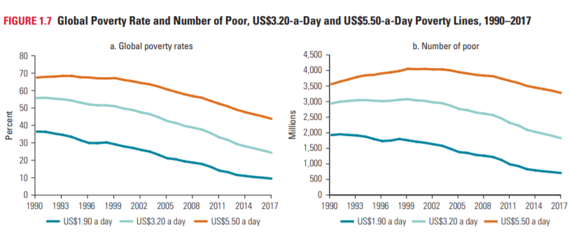
Global poverty…
Despite previous falls in the ‘official’ incidence of extreme poverty globally, there are some important criticisms of the measure. Such criticisms relate to:
    Inadequacy of data collection methods and practices within countries
    Politicising of data and reporting
    Appropriateness of the $1.90 US extreme poverty line measure
Reflecting these criticisms, some suggest that the poverty line should be increased to more accurately reflect the extent and impact of global poverty – as indicated in the graphs here, doing so would significantly alter the picture regarding the extent of poverty around the world.
About a quarter of the global population is living below the US$3.20 poverty line, and almost half is living below the US$5.50 line, compared with less than a 10th living below US$1.90. These figures translate to 1.8 billion people and 3.3 billion people at the US$3.20 and US$5.50 poverty lines, respectively.
This highlights the significance of how poverty is defined and measured
Source: Worldbank, 2020

Slide 11
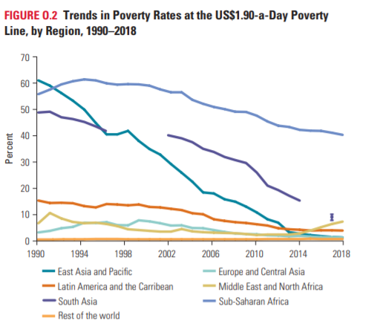
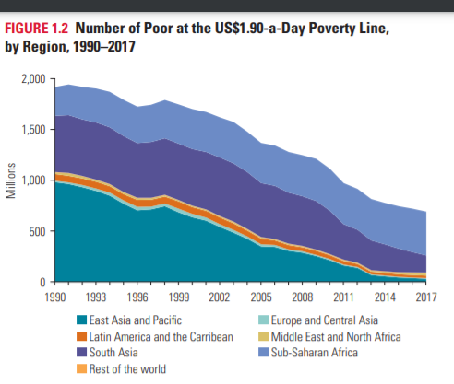
Poverty rates in different regions
Figure 1.2 shows the proportion of the extreme poor in each region for the period 1990–2018.
Issues of note:
It underscores the concerns for Sub-Saharan Africa, which also experienced a slower reduction in poverty than are other regions
The Middle East and North Africa has recently seen its extreme poverty rate rise, from 2.3 percent in 2013 to 3.8 percent in 2015; it then almost doubled to 7.2 percent in 2018
Source: Worldbank, 2020
Source: Worldbank, 2020

Slide 12
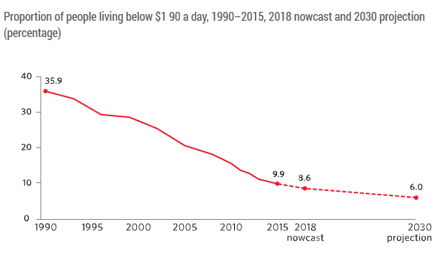
In 2019, progress against extreme poverty continued but was slowing…
In 2019 the UN reported that while the decline of extreme poverty continued, the world was not on track to achieving the target of ending poverty by 2030.
Key issues underpinning this trend include substandard working conditions, inadequate social protections systems, and climate change.
The UN (2019) argued that effective social protection schemes and policies, along with government spending on key services, can help those left behind get back on their feet and find a way out of poverty.
https://unstats.un.org/sdgs/report/2019/goal-01/
Source: UN, Sustainable Development Goals Report, 2019
https://unstats.un.org/sdgs/report/2019/goal-01/

Slide 13
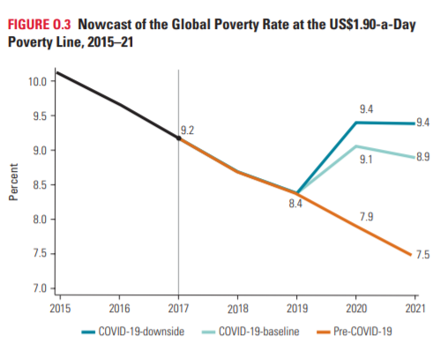
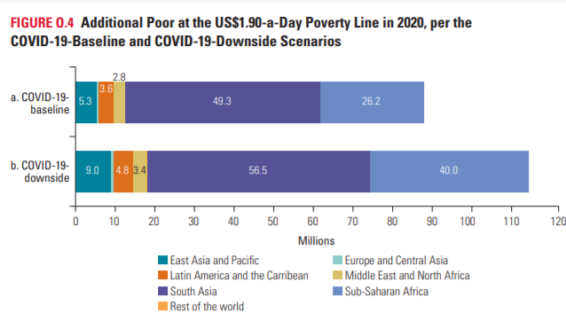
Impact of COVID on global poverty …
Poverty as measured by the international poverty line is expected to rise in 2020 for the first time since 1998 as indicated by the projections on Figure 0.3. The rise in poverty will depend on the degree of economic contraction (See Worldbank 2020, p. 5)
Research by the United Nations has produced estimates of the impact of COVID 19 on global poverty rates. They have found that “even a relatively small contraction in per capita income or consumption of 5 per cent as a result of the COVID-19 pandemic, could lead to an increase in the incidence of income-based poverty for the first time since 1990” (UN 2020, p. 4)
COVID-19 is expected to push some 100 million people into extreme poverty during 2020 alone.
Globally, this poses a challenge to the UN Sustainable Development Goal of ending poverty by 2030 because increases in the number of poor would be the first recorded since 1990 and they could represent a reversal of approximately a decade of progress in reducing poverty.
Countries likely to be worst affected include those in Middle East and North Africa, South Asia, and Sub-Saharan Africa, either because of their relatively slow progress in reducing poverty over the last years or because of their already high poverty levels.
The precarious access to financial resources facing developing countries that is taken for granted in many parts of the developing world has also been highlighted:
“As horrific as this sounds, the situation in the advanced economies is likely to be much more benign than what developing countries are facing, not only in terms of the disease burden, but also in terms of the economic devastation they will face”.
https://www.weforum.org/agenda/2020/03/flattening-the-covid-19-curve-in-developing-countries
In addition to COVID19 and the associated global economic recession, armed conflict and climate change are identified as key causes of global poverty by the Worldbank.
Source: Worldbank, 2020
Source: Worldbank, 2020

Slide 14
UN Human Development Index (HDI)
The UN HDI is an example of a new measures that recognises poverty is multidimensional and a core component of broader development (ie there is a relationship between poverty and development)
It is a measure of a country’s development that attempts to move beyond a singular focus on economic growth to incorporate additional factors to determine how well a country and its citizens are progressing
    Progress against the HDI is detailed in the Human Development Report produced by the UNDP
      http://hdr.undp.org/sites/default/files/hdr2019.pdf

Slide 15
Human development and multidimensional poverty
Underlying the HDI is the concept of multidimensional poverty – that is, that poverty is about more than income and involves a range of deprivations and impacts.
Although previously defined only in monetary terms, poverty is now understood to include the lived reality of people’s experiences and the multiple deprivations they face.
Measured by a multidimensional poverty index (MPI)
Based on the work of Amartya Sen which focussed on understanding poverty and development from the perspective of capabilities
People need to be able to participate in decisions that effect them, but they also need basic capabilities, good health, good education in order to have the freedom to live the life they value and the ability to realise their potential
Based on the idea that a free market economy, and a liberal democracy are the basis of a modern society, but that governments and global institutions must play a critical role through policies that moderate the operations of the economy (eg by addressing inequality, preventing crises, and redistributing resources) and by engaging in coordinated and systematic development efforts
(see http://www.ophi.org.uk/multidimensional-poverty-index/ )
Source: http://www.ophi.org.uk/multidimensional-poverty-index/

Slide 16
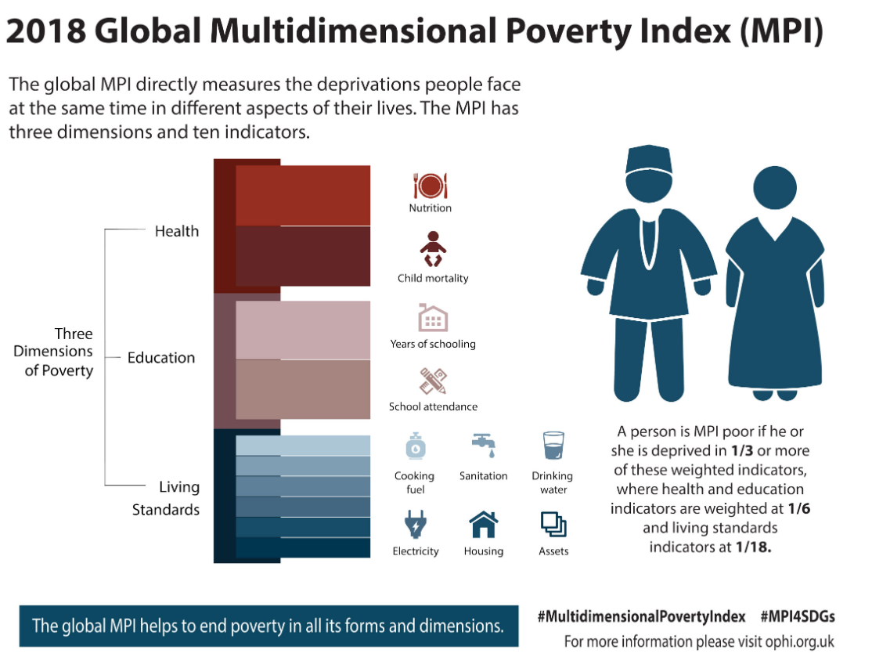

Slide 17
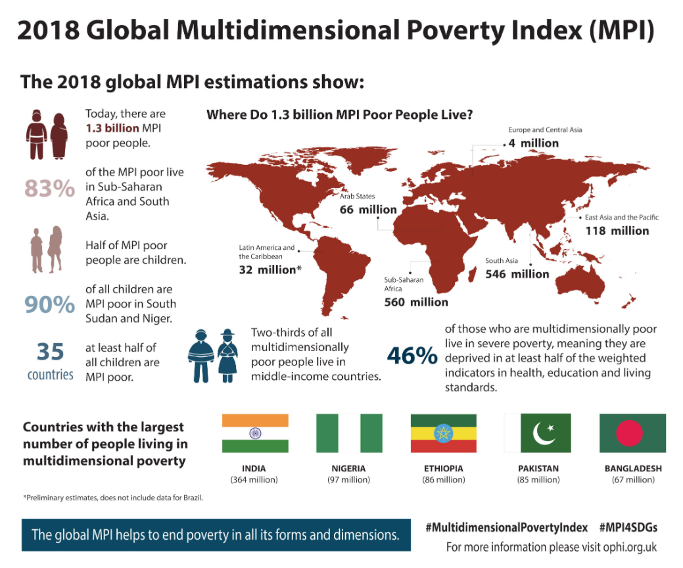

Slide 18
Multidimensional poverty Index in 2020
The 2020 report on the MPI has shown that:
Across 107 developing countries and 5.9 billion people, 1.3 billion people—22 percent—live in multidimensional poverty.
Children show higher rates of multidimensional poverty: half of multidimensionally poor people (644 million) are children under the age of 18. One in three children is poor compared with one in six adults.
About 84 percent of multidimensionally poor people live in Sub-Saharan Africa (558 million) and South Asia (530 million). Two-thirds of multidimensionally poor people live in middle-income countries.
71 percent of the 5.9 billion people covered experience at least one deprivation; however, the average number of deprivations they experience is five.
107 million multidimensionally poor people are age 60 or older—a particularly importantly figure during the COVID-19 pandemic.
Before the pandemic 47 countries were on track to halve poverty between 2015 and 2030, if observed trends continued. But 18 countries, including some of the poorest, were off track.
See OPHI & UNDP (2020) Charting pathways out of multidimensional poverty: Achieving the SDGs, United Nations Development Programme and Oxford Poverty and Human Development Initiative. https://ophi.org.uk/global-mpi-2020/

Slide 19
In summary
The current global context is complex and characterised by persistent issues of inequality and poverty, in which the global economic system and global institutions play a key role
Whilst some data indicates positive trends, we need to be critical in how we interpret such data and consider trends both within and between countries
The full impact of COVID 19 on global poverty remains to be seen but trends indicate it will undermine progress made
Contemporary efforts to measuring global poverty more broadly than income are reflected in the development of the HDI and MPI

Slide 20
References
Anand, S., Segal, P., & Stiglitz, J. (Eds.). (2010). Debates on the measurement of global poverty. Oxford: Oxford University Press. DOI: 10.1093/acprof:oso/9780199558032.001.0001
Anand, S. & Sen, A. (1997). "Concepts of Human Development and Poverty: A multidimensional Perspective" Human Development Papers Human Development Report Office New York pp. 1-19
Centre for Economic and Social Rights (2009). Human rights and poverty: Is poverty a violation of human rights? Retrieved from http://www.cesr.org/downloads/CESR%20Briefing%20-%20Human%20Rights%20and%20Poverty%20-%20Draft%20December%202009.pdf
Credit Suisse, (2019) Global Wealth Report. Credit Suisse Research Institute.
OPHI & UNDP (2020) Charting pathways out of multidimensional poverty: Achieving the SDGs, United Nations Development Programme and Oxford Poverty and Human Development Initiative. https://ophi.org.uk/global-mpi-2020/
Serr, K. (2013). Against the odds: Poverty in Addis Ababa. North Melbourne: Australian Scholarly Publishing.
Serr, K. (2017). Poverty, wealth and the structures of global capitalism. In K. Serr (Ed.). Thinking about poverty (4th ed., pp. 11-27). Annandale: Federation Press.
Sumner et al (2020), Estimates of the impact of COVID-19 on global poverty, WIDER Working Paper 2020/43, United Nations University World Institute for Development Economic Research.
United Nations Department of Economic and Social Affairs (2013). Inequality matters: Report on world social situation 2013. New York: United Nations.
United Nations Development Program (2019). Human Development Report 2019: Beyond income, beyond averages, beyond today: Inequalities in human development in the 21st century. New York.
Sumner et al (2020) Estimates of the impact of COVID-19 on global poverty WIDER Working Paper 2020/43, United Nations University World Institute for Development Economic Research. Retrieved from: https://www.wider.unu.edu/sites/default/files/Publications/Working-paper/PDF/wp2020-43.pdf
World Bank Group (2020) Reversals of Fortune: Poverty and Shared Prosperity, World Bank Group, Washington.

